Slide 1

PES’s Modern College of Engineering, Shivajinagar, Pune-5. Department of Electronics and Telecommunication A.Y. – 2021-22
IoT Based Multifaceted Rover
Names of the students :-
1. Priya Kokil.
2. Poorva D. Patil.
3. Tejas S. Patil.
Name of Guide- Dr. Mrs. Vandana N. Jirafe

Slide 2
Introduction
1. The main purpose of this project is to make a Rover capable of doing
multiple tasks.
2. It will consist of multiple systems ,capable of performing multiple
functionalities.
3. Robotic Arm , Sensors (consisting of various sensors like
Gas, Fire & temperature - Humidity) will be controlled by ESP8266 module &
Camera system will be controlled by ESP32 Cam Module.
4. Control system will control the maneuvering of Rover & the speed of the
rover.
5. A camera module is mounted on the rover, which will capture the photos &
stream live video, which can be displayed on a website (IP Address).

Slide 3
Literature Survey
Objective of our project.
The project aims to build a multipurpose rover
that can be operated by using Blynk App.
Another example is the case of mining.
In military too, there are many situations, which would be made less risky if an unmanned object is first sent for scouting before the troops are sent.

Slide 4
Name of our Project | IoT Based Multifaceted Rover
Name of IEEE Paper | Multipurpose Unmanned Rover in Wi-Fi Wireless Sensor Network
Name of Author | Lyla B Das, Vijay Anandh K., K Subash Chandra, M Narendra Reddy.
Year of Publishing | 2018
Applications | Rover can be controlled by a remote-control mechanism. Physical data from sensors can be sent on cloud server. Mining Military applications
Advantages | The sensors can detect various values. This rover can be used in the delivering products. Helpful in a coal mine
Disadvantages | The project is bulky. Low-Range control of rover.
Conclusion of IEEE paper | The unmanned rover that could realize the objectives was made and tested. It included various sensors like temperature sensor, vibration sensor, etc. Also, with the help of motion detection feature, the rover could take pictures if a movement is detected. With all these features, the rover could be used for multipurpose application with remote accessibility

Slide 5
Market Survey
Name of Component | Reason for selecting or rejecting
PCA-9685 16 channel PWM Servo Driver | The PCA9685 is a 16-channel I2C-bus controller optimized for controlling the servo motors . Each output has individual 12-bit resolution (4096 steps) PWM controller with a fixed frequency. The 16-channel 12-bit PWM Servo Driver only needs 2 pins to control 16 servos, thus greatly reducing the occupant I/Os.
Wi-Fi Module ESP8266 | ESP8266 can give any microcontroller access to your WiFi network. It is Low cost, compact and powerful Wi-Fi Module and requires Power Supply of +3.3V only.
ESP32-CAM Module | The ESP32-CAM is a small size, low power consumption camera module based on ESP32. It comes with an OV2640 camera and provides onboard TF card slot. The ESP32-CAM can be widely used in intelligent IoT applications.
Node-MCU V3 – Motor & Sensor Shield | This shield board has many pins, such as VIN, 3.3V, DIO, AIO, SDIO, UART, SPI, RST, and EN, thus can connect all kinds of sensors conveniently. The board is developed with a power switch, and thus user can control the on-off of power conveniently.

Slide 6
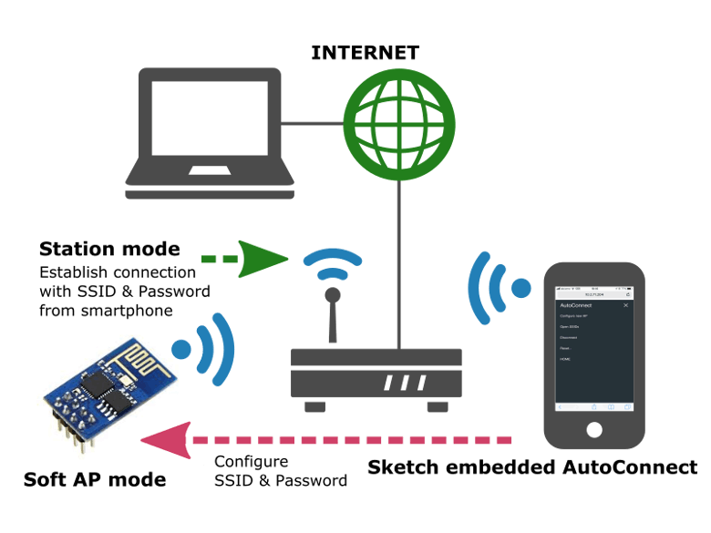
Block Diagram(Control System) :-
Right side DC Motors
Website
(URL)
ESP32-
Cam-
Module
L293D
Motor
Driver
9.6 V
Power
Supply
Left side DC Motors

Slide 7

Robotic Arm, Sensors Control System :-
Robotic Arm
(6 DOF)
(6 Servos)
Gas
Sensor
BLYNK
APP
( Transmits signals to ESP8266 in order to control robotic arm )
LED
Servo Motor
Driver
WIFI
Module
[ESP8266]
Node-MCU shield
Fire
sensor
6.9V ,4A
Power Supply
6.9 V
Power Supply
DHT -11
Temp. Sensor

Slide 8
App controlling the Robotic Arm :-
BLYNK APP
CONTROLLING
Robotic Arm.
WIFI Module
&
Servo Shield
Sensor
Physical data
Wireless Network
WIFI
Module
BLYNK APP
To Access the information.

Slide 9
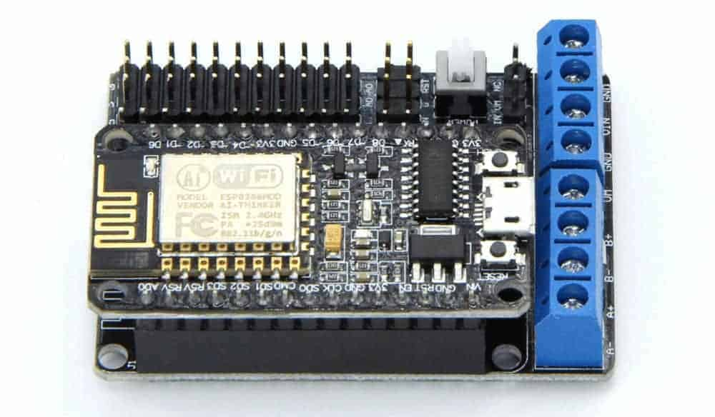
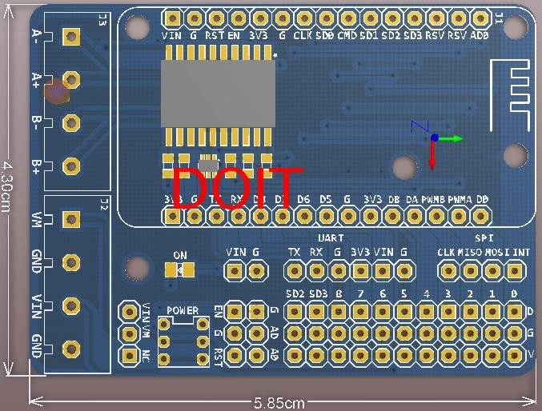
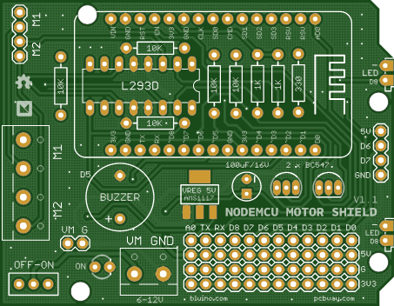
Hardware Design :-
Node-MCU V3
L293D
Sensor Shield
(PCB Design)

Slide 10
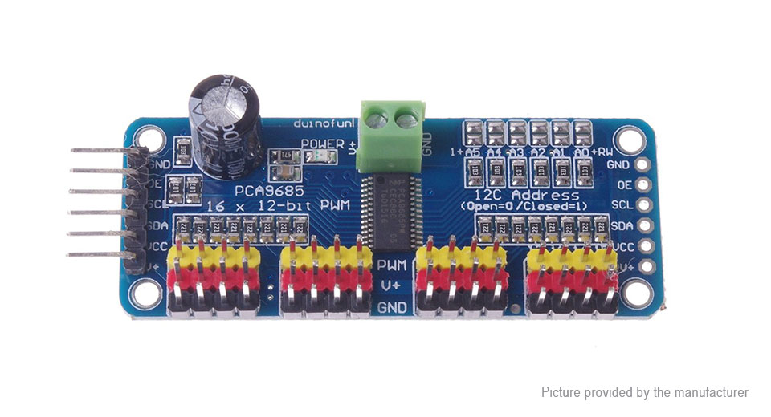
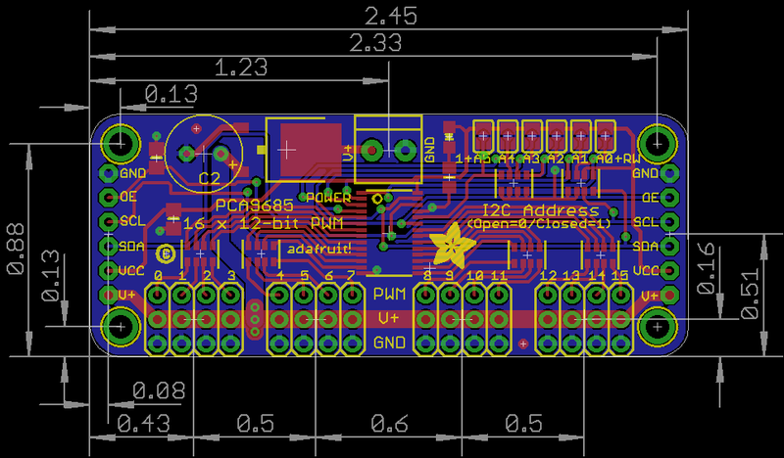
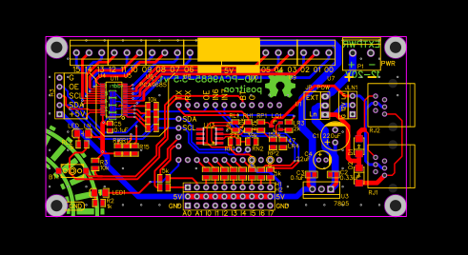
2] PCB Design of PCA9685 Servo Shield :-

Slide 11
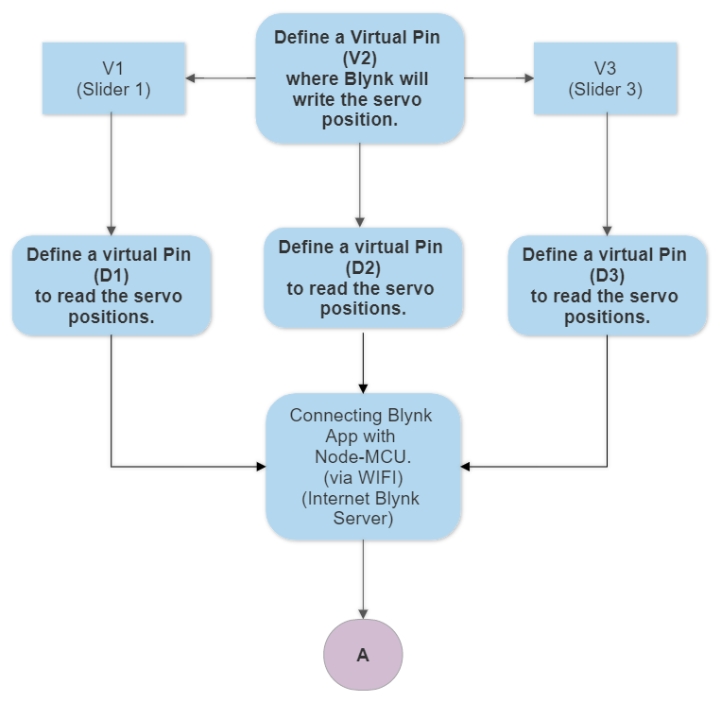
Software Design :-
Flowchart For Controlling Robotic Arm:-
(BLYNK APP with Sliders)

Slide 12
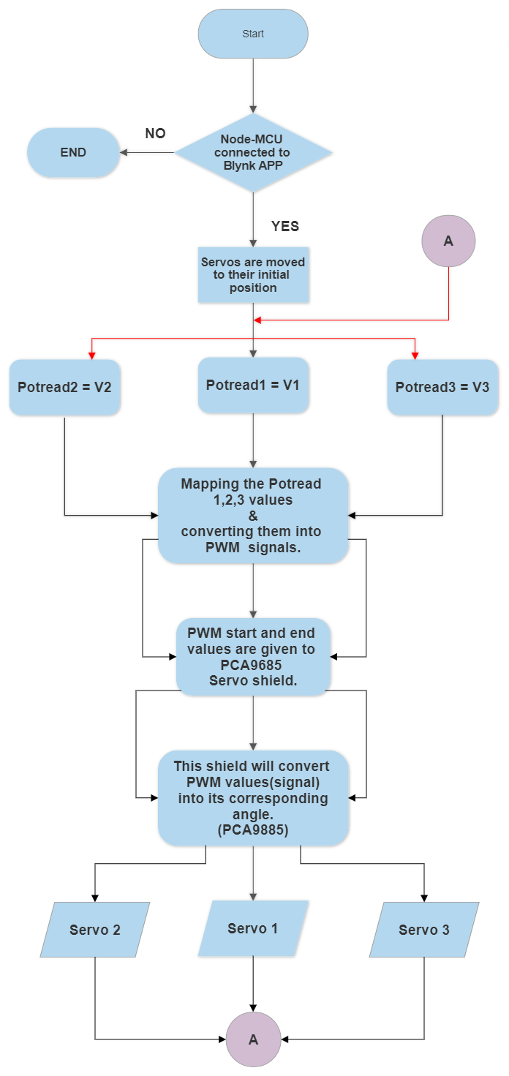
Flowchart for Controlling Robotic Arm:

Slide 13
Working of project
1] Rover will be controlled via a webpage, through which we can
accelerate it forward or backward , & can turn it left or right.
2] The Robotic Arm will operate in 6 degree’s of freedom (i.e. 6 DOF) and
these 6 rotations will be controlled by servo motors.
3] The servo motors will have a rotation limit upto180 degree’s, & angle of
rotation of these servo motors will be controlled via BLYNK APP.
4] Sensor unit consisting of various sensors will read the physical data from
surrounding and send the digital data via WIFI module to the BLYNK APP
where we can monitor the sensor’s data.
5] Rover maneuvering system & live video streaming will be controlled by ESP -32
Camera module .
6] Sensor unit & Robotic arm will be controlled by a WIFI + controller (Node-Mcu)
module and data from various sensors will be processed by this Module.

Slide 14
Sensors Control Algorithm :-
1] Sensors like Gas, fire, temperature-Humidity ,will sense the
physical data from the surrounding.
2] This physical data will be processed by Node-MCU controller and
that data will then be transmitted to IOT cloud platform
BLYNK in order to analyze it in the form of graphs, gauges,
etc
3] 4 IMP steps to setup any sensor with Node-MCU :-
1] Connecting sensors to Node-MCU controller(Circuit diagram).
2] Writing respective code for respective sensor in order to covert
the physical data of that sensor.
3] Setting up Blynk App & Getting Authentication code.
4] We will send the sensors data to the Blynk App and finally, we
will display the sensors data through Gauges and
Super - Charts on the IOT platform.

Slide 15
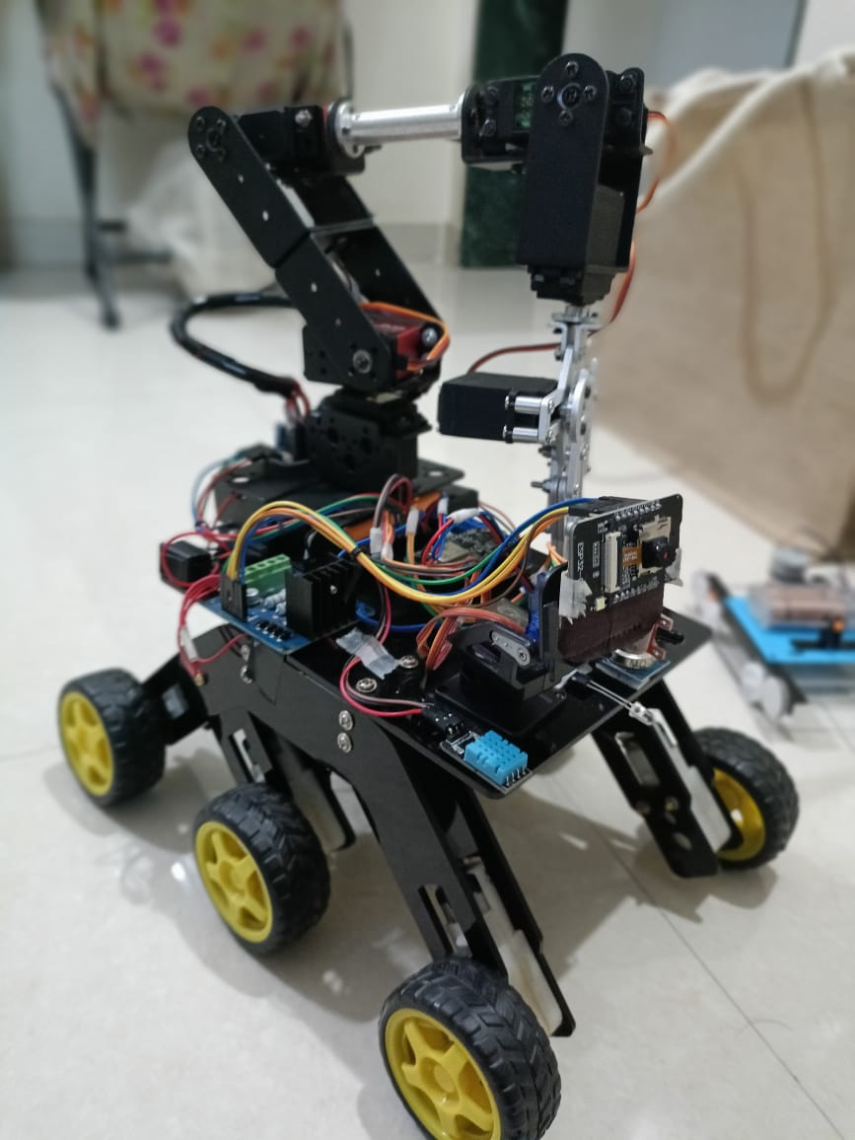
Result 1 :-

Slide 16
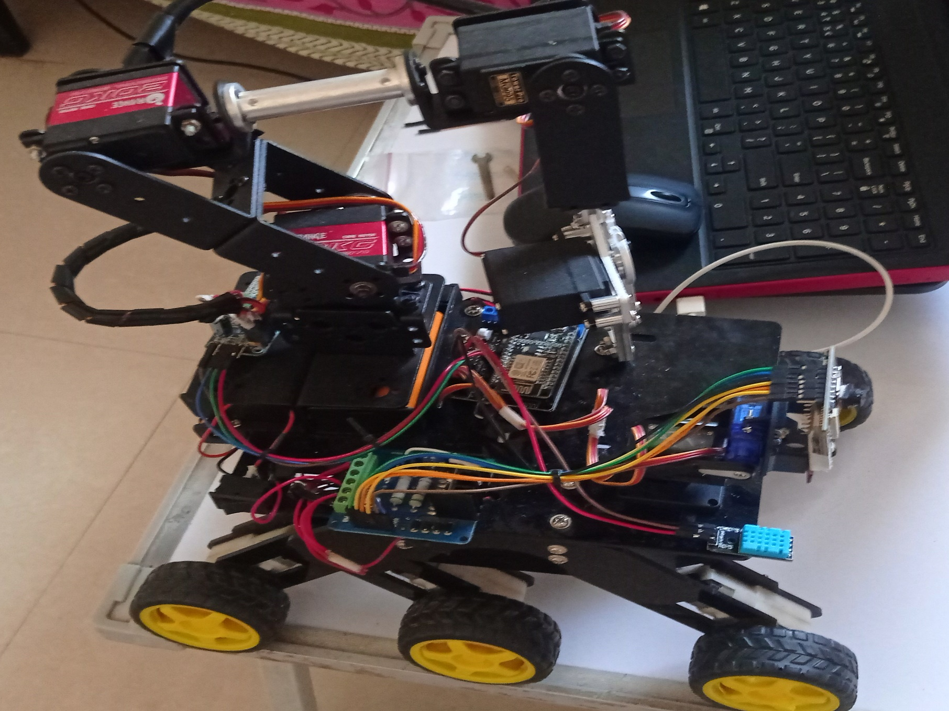
Result 2 :-

Slide 17
Applications :-
1] Like surveillance, navigation and monitoring applications.
2] For the detection of extreme temperature, gases inside mines,
industrial go-downs, storage area of toxic materials, explosives
etc. where safe and direct human access is difficult.
3] Video transmitters can be used for security applications in
different areas (military).
4] Used for detecting the presences of live human body from the
natural calamities like earthquake ,etc.
5] In Archaeological activities.

Slide 18
Future Scope :-
1] Pixy 2 Camera module can also be added to this rover for proper detection of various objects and road signs in the surrounding Environment.
2] 15 kg MG995 Servo motors can be replaced by Orange 20kg servo motors in order to lift heavy objects without wear and tear of any gears of servo motors.
3] Metal chasis can be used instead of acrylic chasis in order to make rover more robust to the surrounding environment.
4] More sensors can be interfaced with NodeMCU shield in order to provide more data of the surrounding environment.

Slide 19
Conclusion :-
1] In this project , we have assembled the robotic arm &
sensor unit which is controlled by one controller
(Node-MCU) .
2] The Movement of rover & the video live streaming is
controlled by another controller i.e. ESP32 CAM Module.
3] In this ,we learned about Web-socket , in order to
improve half duplex communication of HTTP server.
4] We also learned about , the PWM pulse-width calculations
required for the servo shield (PCA 9685).

Slide 20
References :-
[1] Islam T, Abdullah SA, Sarowar G, Enhanced wireless control system for smoke and fire detection. International Journal of Computer and Electrical Engineering. 2013 Apr 1;5(2):233-6.
[2] Rounak R. Gupta, Mr.Laxmikant S. Hundikar, Abhijit G. Ingole, Microcontroller based Earthquake Detection using Sensing Element, International Journal of Electrical, Electronics and Mechanical Controls, 2013 January, 2(1).
[3] Kumar R, Khalkho AN, Design and implementation of metal detector using DTMF technology, IEEE International Conference on Signal Processing,
Communication, Power and Embedded System (SCOPES), 2016 Oct 3, pp. 368-371.
[4] Appelqvist P, Knuuttila J, Ahtiainen J, Development of an Unmanned Ground Vehicle for task-oriented operation-considerations on teleoperation and delay, IEEE/ASME international conference on Advanced intelligent mechatronics, 2007 Sep 4, pp. 1-6

Slide 21
THANK YOU

